Slide 1
6.036/6.862 Recitation 2
TAs: Liang Zhou, Helen Zhou

Slide 2
Perceptron
+
+
+
—
—
—

Slide 3
Perceptron
decision boundary
+
+
+
—
—
—

Slide 4
Perceptron
decision boundary
+
+
θ
+
—
—
—

Slide 5
Perceptron
(1, 3)
Θ = (0, 0)
—
(-1, 1)
(5, 1)
—
+

Slide 6
Perceptron
(1, 3)
Θ = (5, 1)
—
(-1, 1)
(5, 1)
—
+
θ

Slide 7
Perceptron
(1, 3)
Θ = (4, -2)
—
(-1, 1)
(5, 1)
—
+
θ

Slide 8
Support Vector Machines
easy :D
+
+
+
—
—
—

Slide 9
Support Vector Machines
+
hard D:
+
+
—
+
—
+
—
—

Slide 10
Support Vector Machines
decision boundary
+
+
+
support vector
support vector
—
—
—

Slide 11

Support Vector Machines
decision boundary
+
+
$$\frac{θ∙x}{\left\|θ\right\|}$$
+
support vector
support vector
—
—
—

Slide 12

Support Vector Machines
margin
decision boundary
+
+
$$\frac{1}{\left\|θ\right\|}$$
+
support vector
support vector
—
—
—

Slide 13
Support Vector Machines
+
—
+
+
+
—
+
+
—
—

Slide 14
Support Vector Machines
+
—
+
+
+
—
+
+
—
—

Slide 15
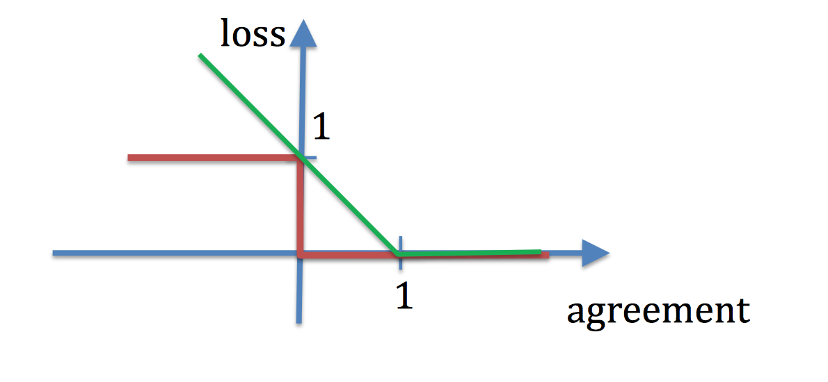
Loss Functions
Hinge Loss
0 – 1 Loss

Slide 16
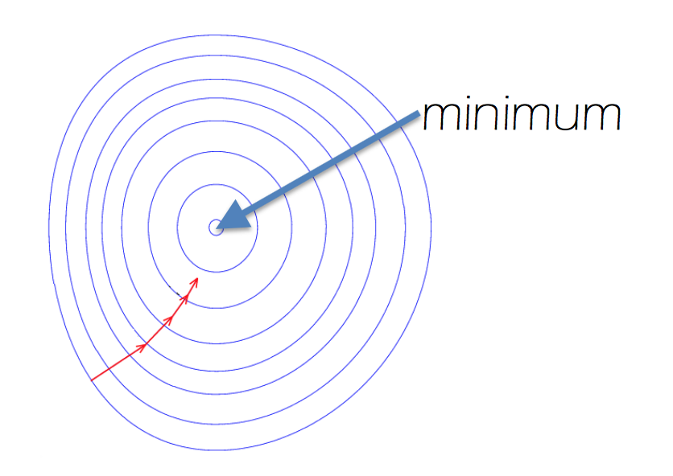
Gradient Descent

